Slide 1


FinanViz: Visualizing Emerging Topics in Financial News
Presenter
Dr. Tommy Dang
Assistant Professor, Texas Tech University
PhD Students
Ngan V. T. Nguyen
Vinh Nguyen
Vung Pham

Slide 2
Outline
Introduction
Background and related work
Visualization architecture
Case study
Conclusion and Future work

Slide 3




Introduction
Social media
website
Financial news
potential customers
market demands
Social network
generate new products
evaluate financial risks

Slide 4
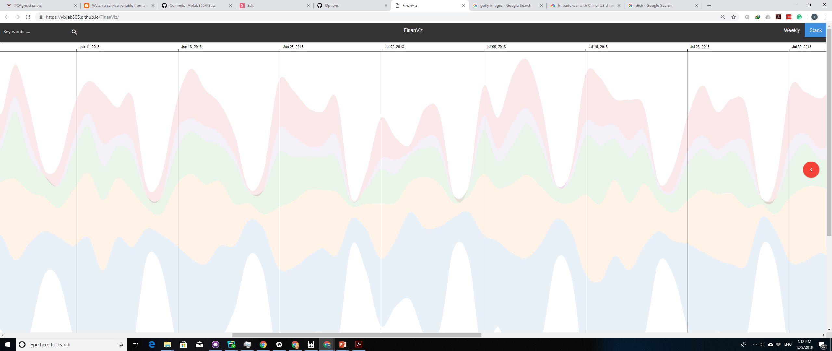
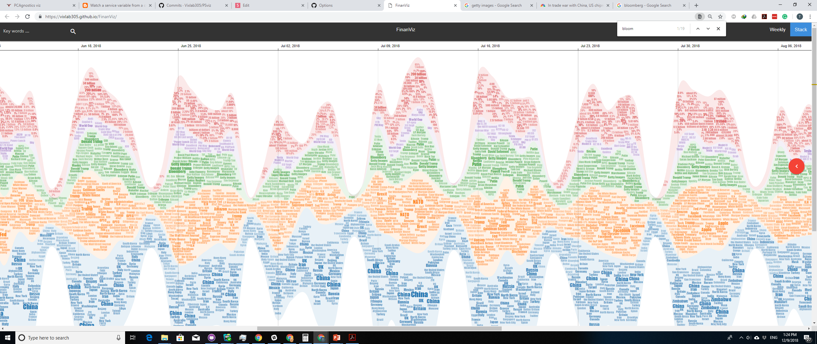
Project Overview
NEWS
TERMS
TIMELINE
UK
$200 billion
34 billion
China
Bloomberg
+
Brexit
Facebook
Getty Images
Dynamic terms/topics behavior over time
Notes:
Bloomberg L.P. is a privately held financial, software, data, and media company headquartered in Midtown Manhattan, New York City.

Slide 5
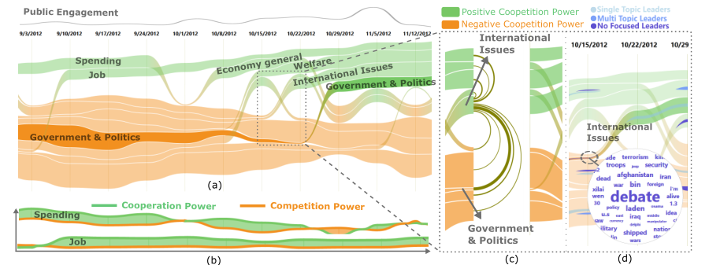
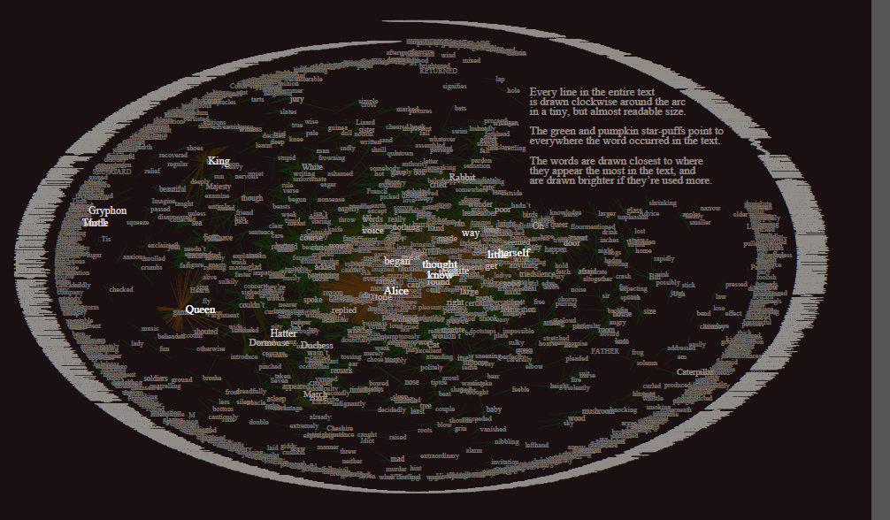
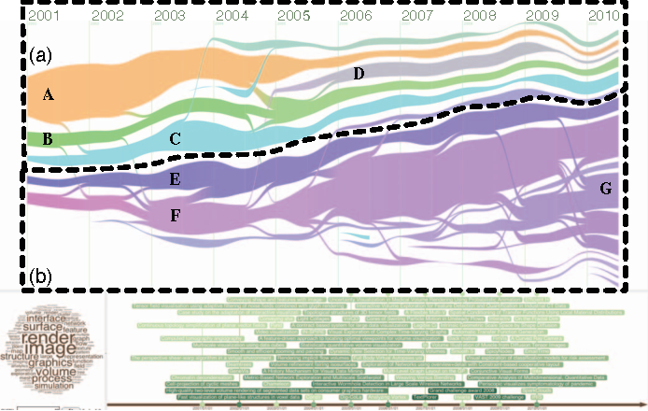
Related work
EvoRiver separate the negative and positive threads
Text visualization
+ focus on topic evolution
- not their correlations
TextFlow
TextArc

Slide 6
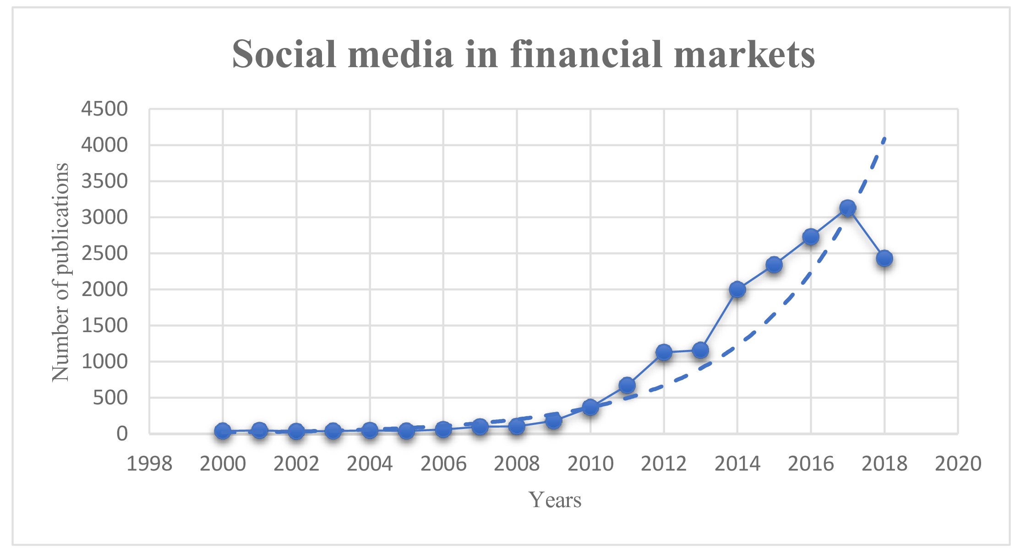
Related work
Financial analysis from social media
Goal: the interesting insights from social media data
Number of publications on social media in financial markets from Google Scholar

Slide 7
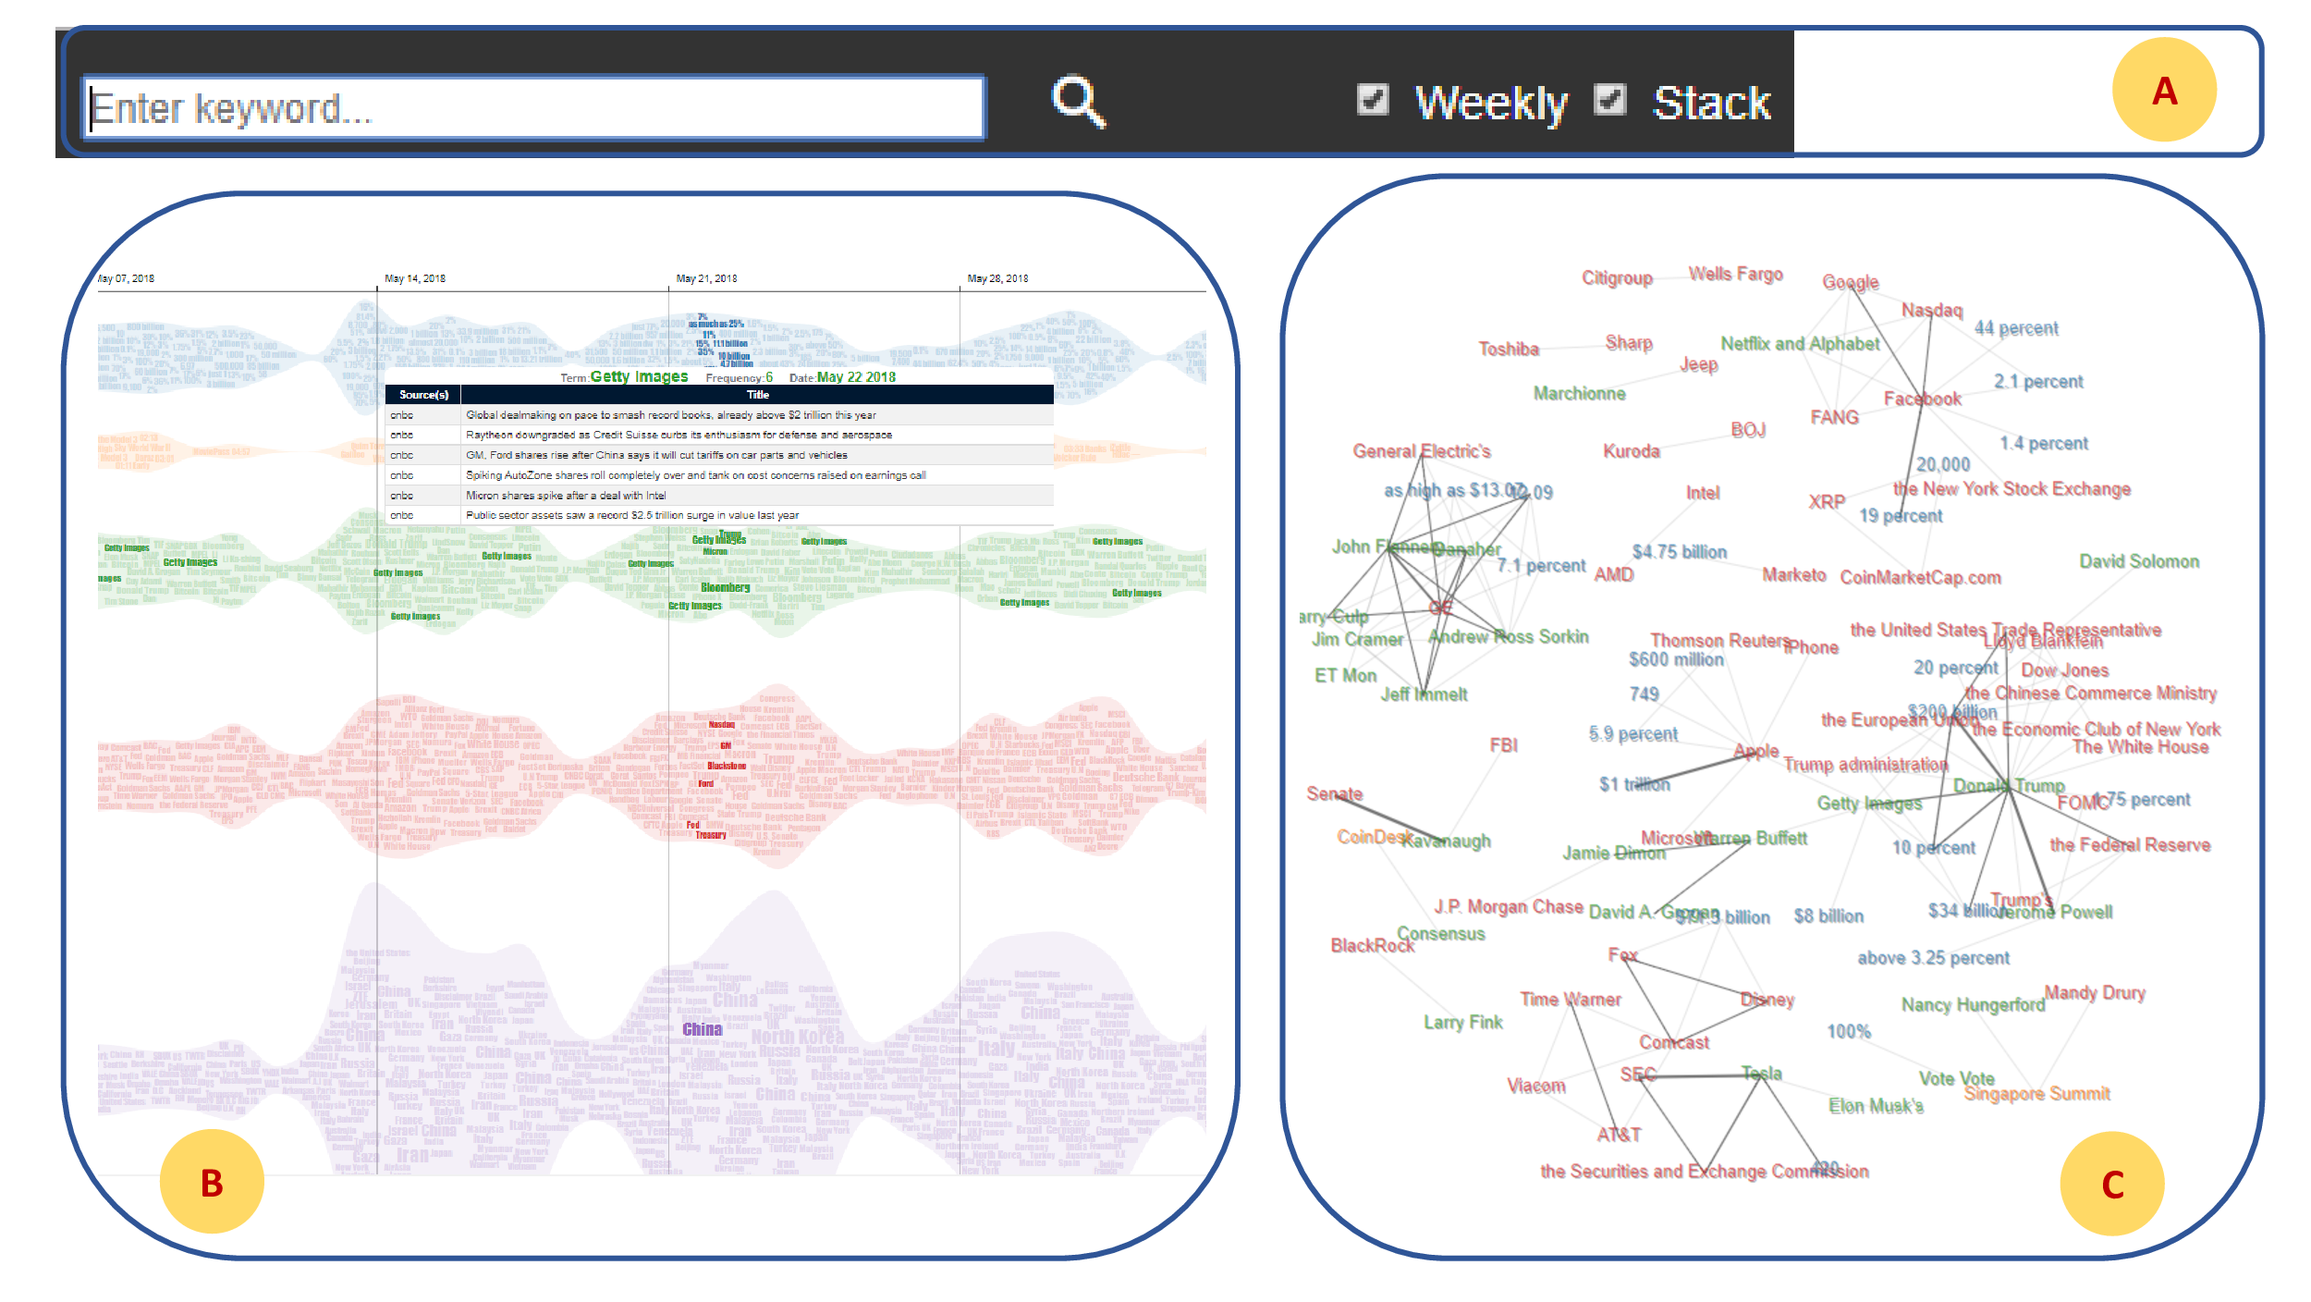
Visualization architecture
Utility component
Topics stream component
Dynamic network component

Slide 8
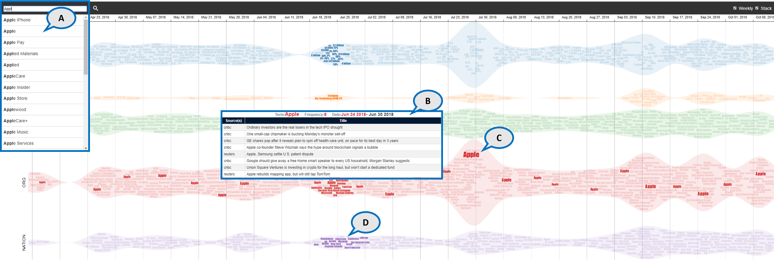
User interactions
Search box with “auto complete” widget
Detail of current term with mouse over
Appearance of the terms over time
Other terms related to current search word at the same time

Slide 9
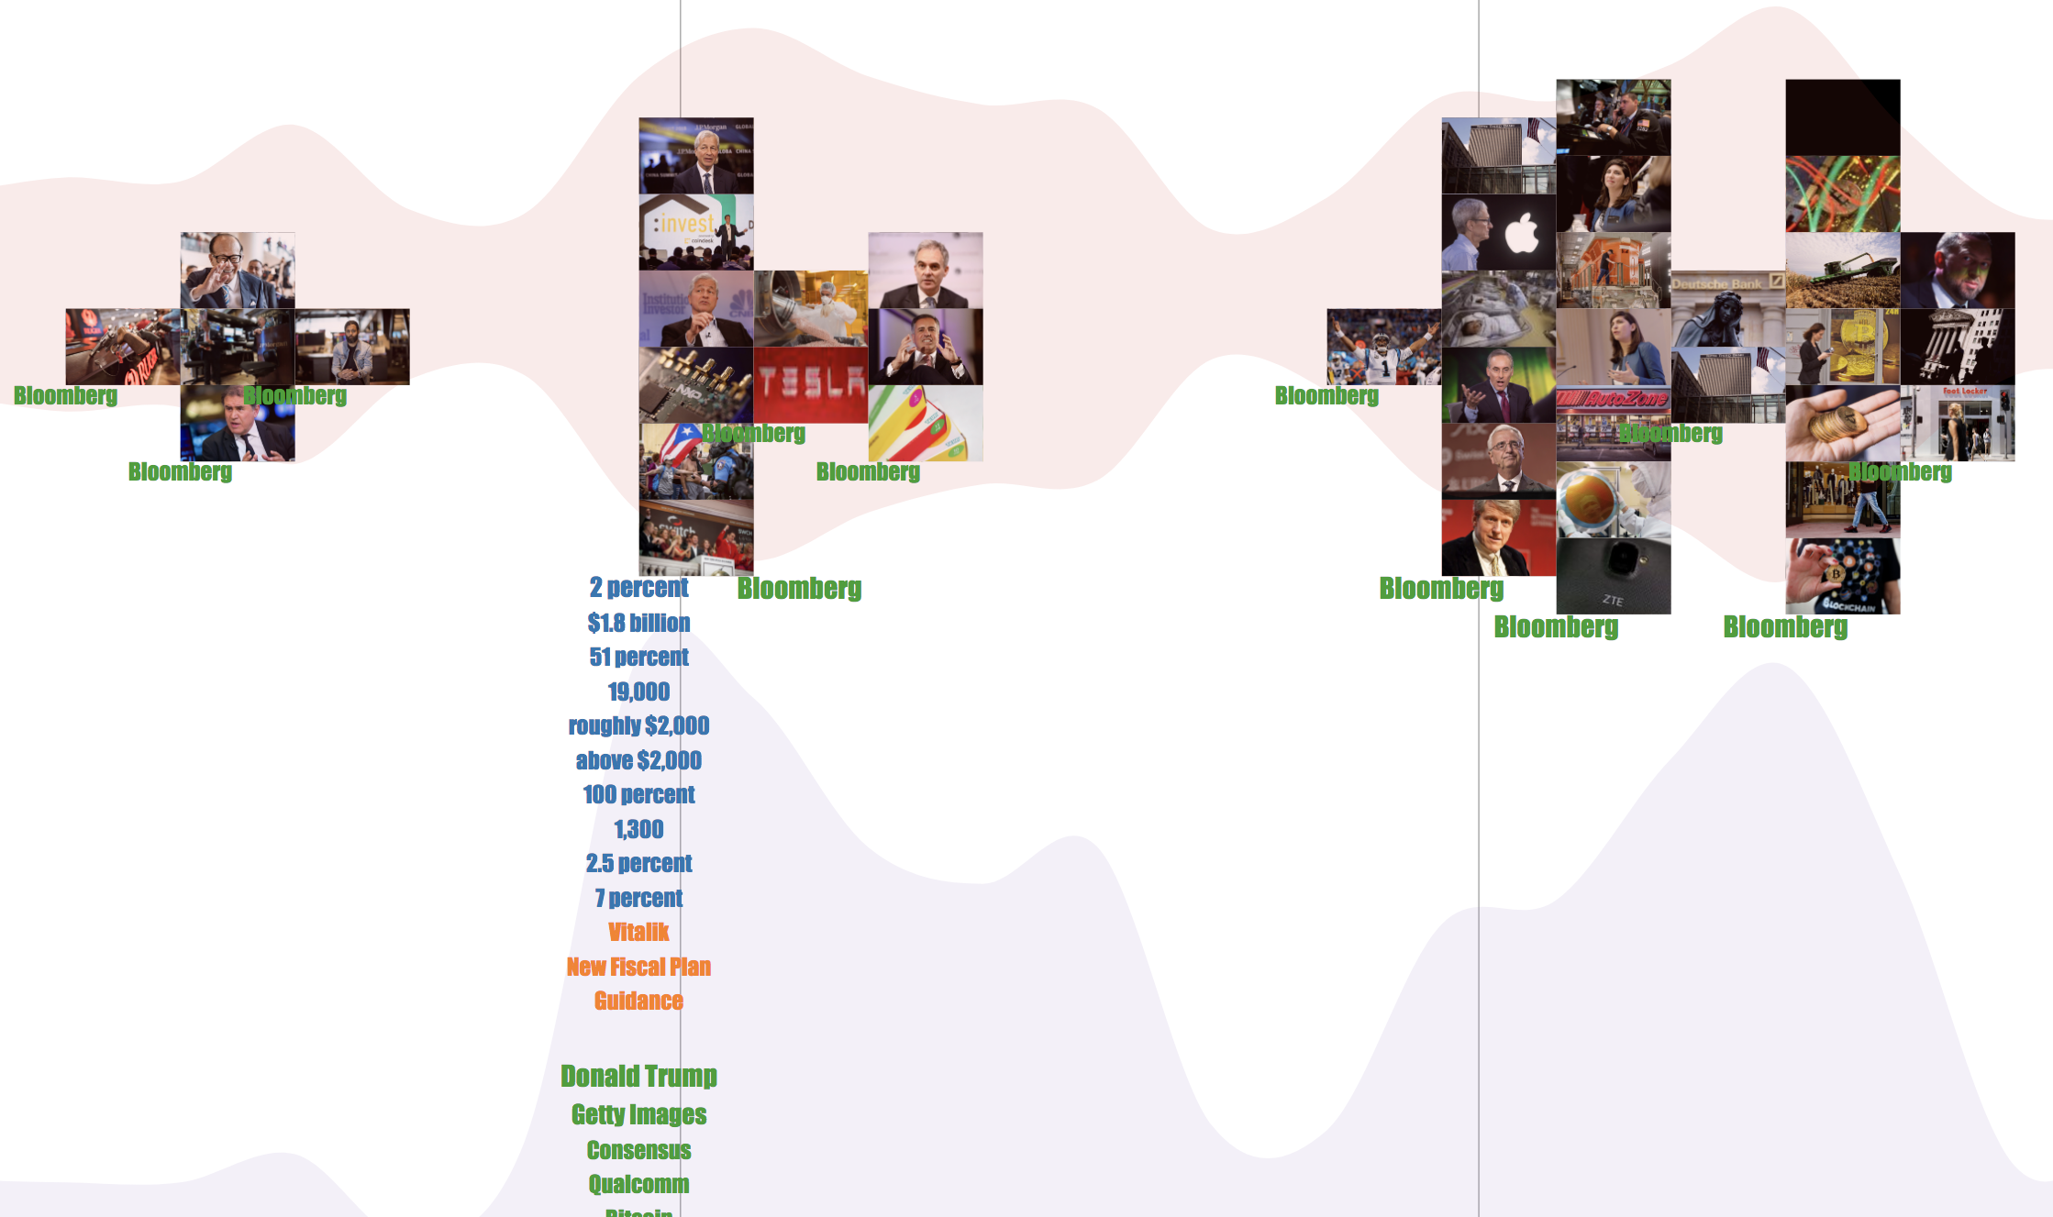
User interactions (cont.)
Mouse click allows users to:
glance over a thumbnail of article’s image over a period.
navigate to webpage of the article.

Slide 10
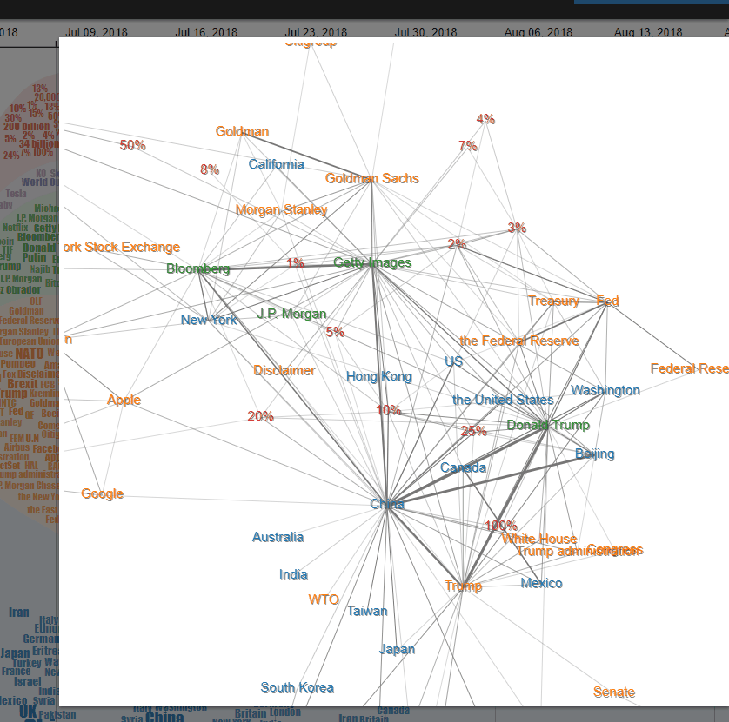
User interactions (cont.)
Mouse event:
Drag and drop
Zoom
Right click to search term in application

Slide 11
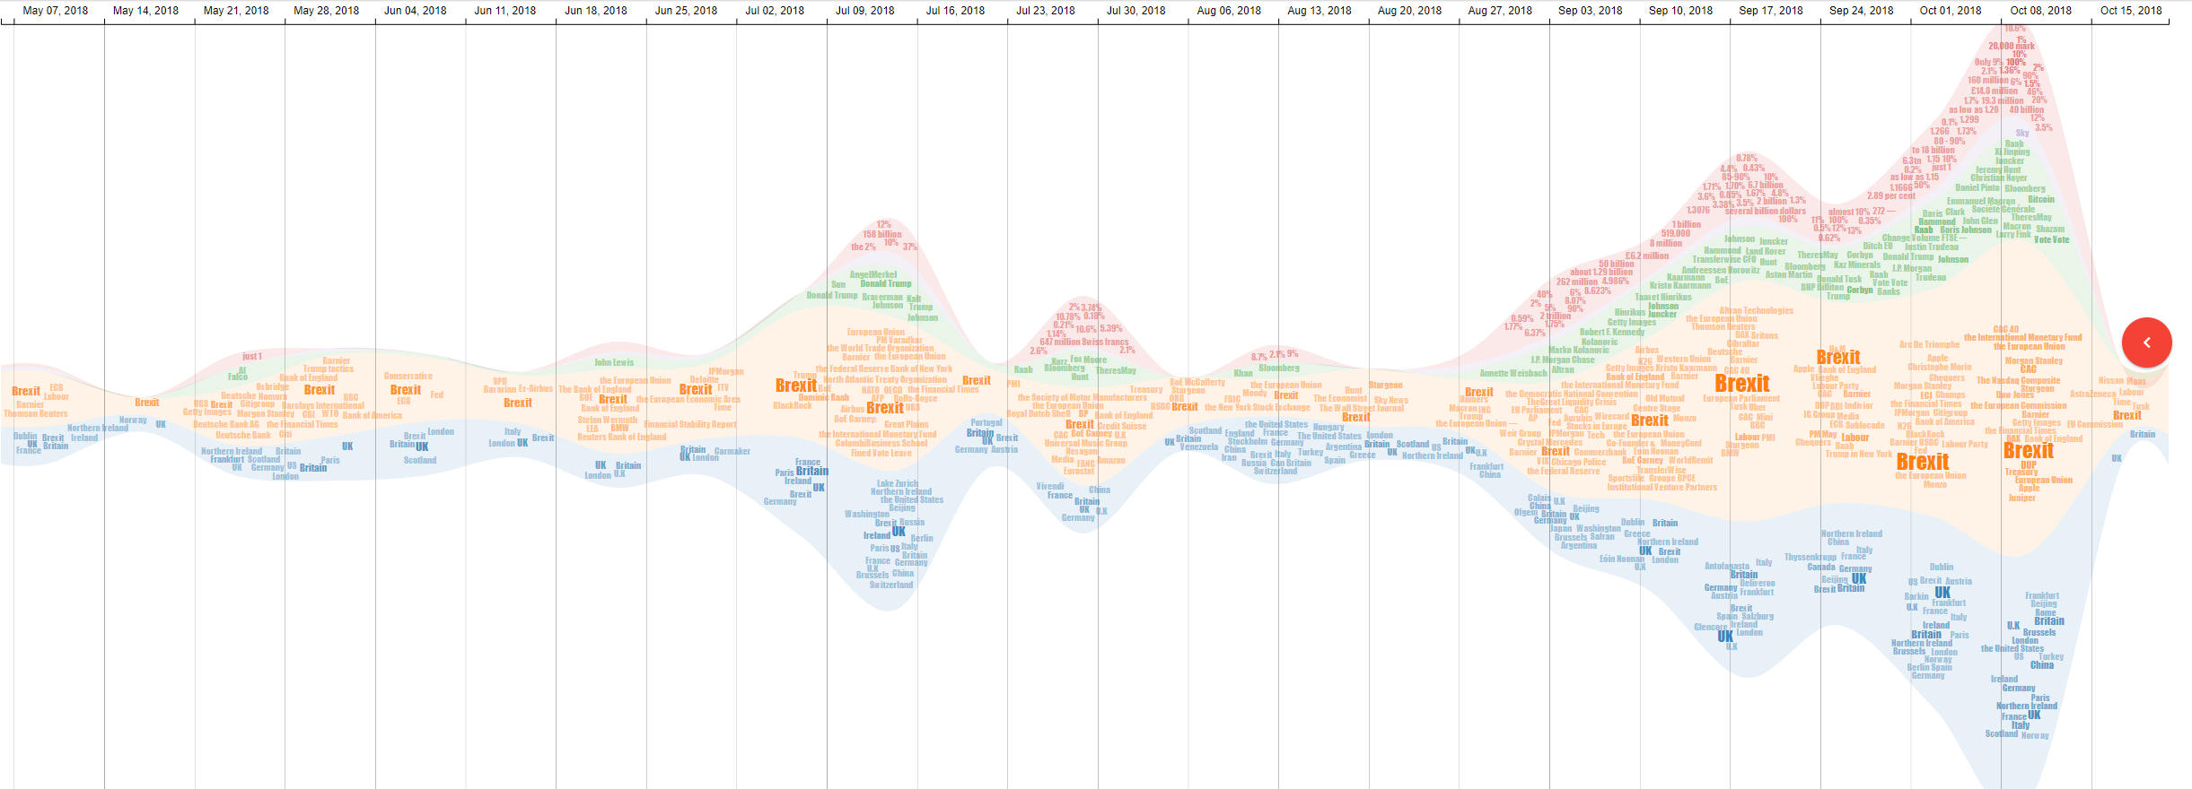
Case study
Brexit = British exit
“Brexit” and financial issues in the last quarter of 2018

Slide 12
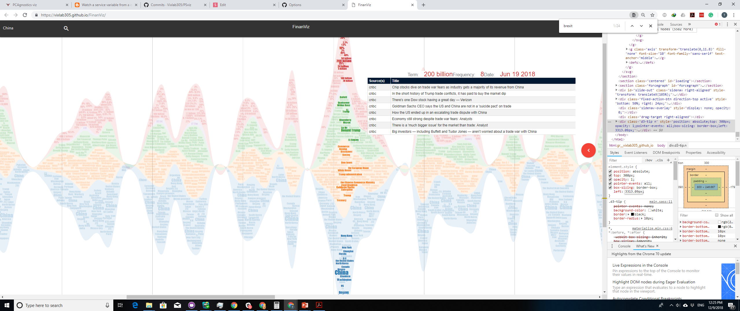
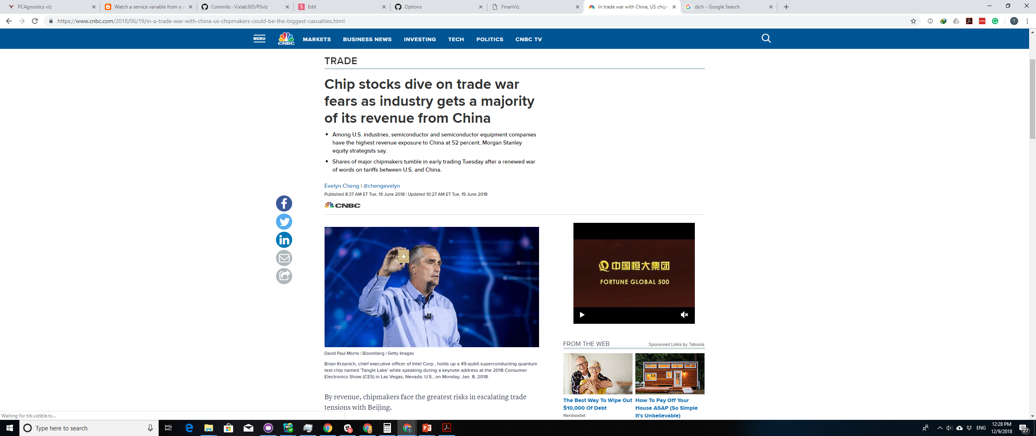
Case study
Jun 19 2018
Financial issue related to
China and $200 billion

Slide 13
Conclusion and Future work
We:
Introduced FinanViz - a graphical tool analysis emerging trends from financial news based on the co-occurrence of related terms within a topic or across multiple topics over time, and the relationship sudden change of trending terms spanning multiple years
Future work:
collaborating with experts in financial department to improve the FinanViz
extract, interpret terms in a more meaningful manner

Slide 14


Questions?
Email: Tommy.Dang@ttu.edu
interactive Data Visualization Lab

